Slide 1
Generating Music Using GAN
Presented by
Dina Ahmed El Sayed Fathy Supervised by
Prof.Doc Mohamed Abo Rezka

Slide 2
Table of contents
01
02
03
04
Paper 1
Introduction
Investigation on Automatic Music Generation using GAN & LSTM
Paper 2
Paper 3
Bridging Paintings & Music-Exploring Emotion based Music Generation through Paintings
Symbolic Music Generation with Transformers-GANs

Slide 3
01
Introduction

Slide 4
Problem Definiton
Goal
Developing a system that cab autonomously generate coherent music

Slide 5
Problem Definiton
Goal
Challenge
Developing a system that cab autonomously generate coherent music
Capture music pattern ,styles & structures in a way resembles human composition

Slide 6
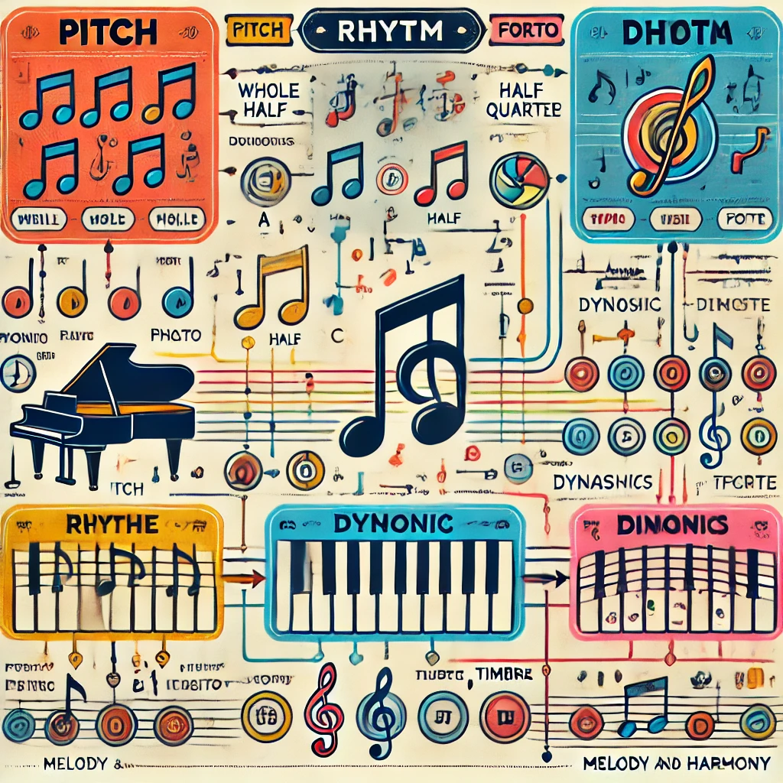
Musical Notes and Music Generation
Musical notes are symbols that represent specific pitches and durations in music. They are used to create melodies, harmonies, and rhythms when arranged in various patterns and played on musical instruments.

Slide 7
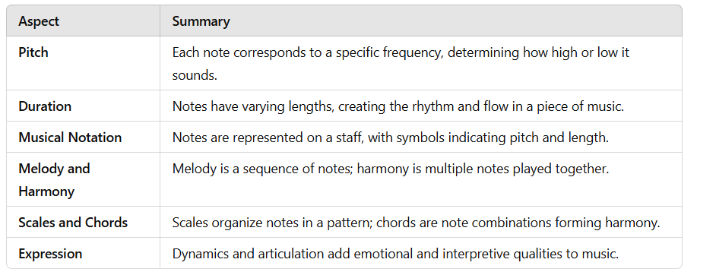
Musical Notes and Music Generation

Slide 8

Difficulty of Music Generation without AI
Without AI, generating music is challenging because it requires extensive musical knowledge, creativity, and time to manually compose, arrange, and refine melodies, harmonies, and rhythms.

Slide 9

AI Role in Music Generation
Analyzing vast amounts of musical data to learn patterns ,styles & structures
Using Knowledge to autonomously generate new music compositions
Often use deep learning algorithms enabling creation of human creativity.

Slide 10
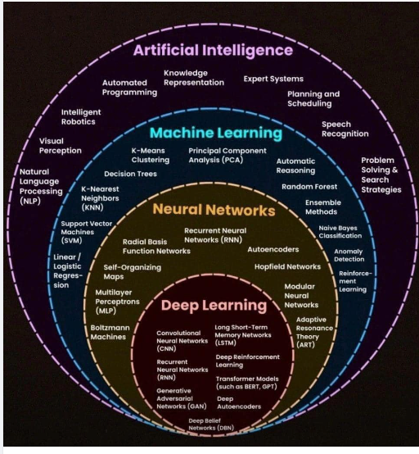
What is Artificial Intelligence(AI)?
A field focused on creating systems that can perform tasks typically requiring human intelligence, such as understanding language, recognizing patterns, and making decisions.

Slide 11
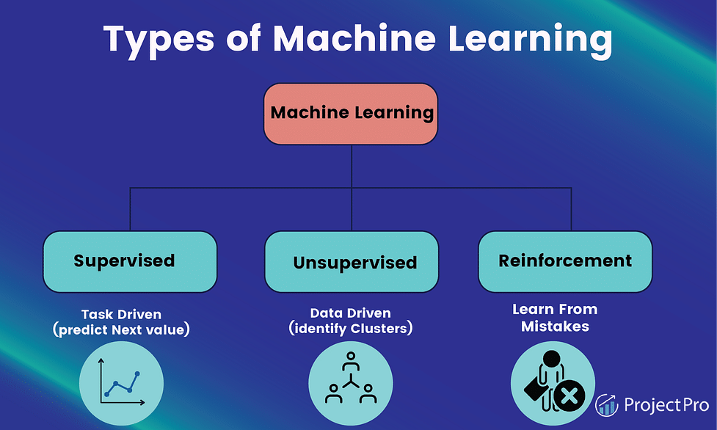
What is Machine Learning(ML)?
Subset of AI enables system to learn from data and improve over time without explicit programming.

Slide 12
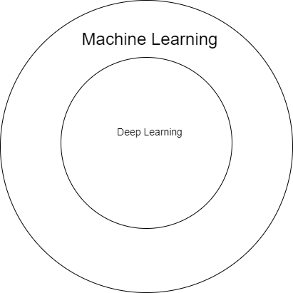
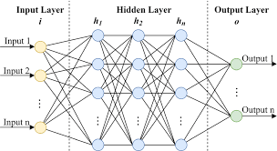
What is Deep Learning?
A branch of Machine Learning that uses neural networks to model complex patterns
Neural Network(NN)

Slide 13
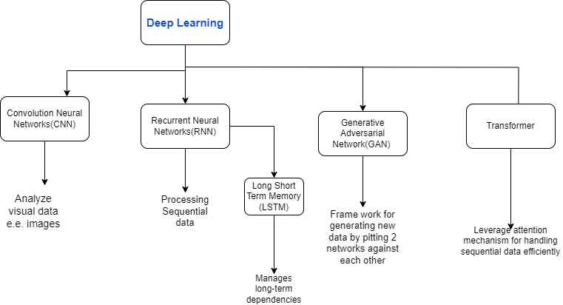

Slide 14
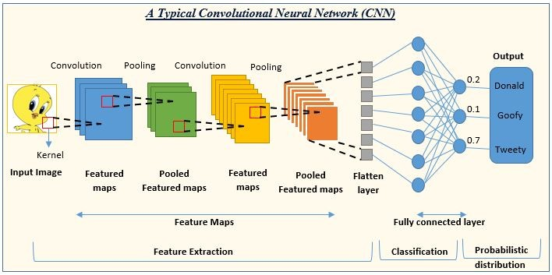
Convolution Neural Network (CNN)
Type of NN most applied to analyze visual data(e.g.images,videos,etc,..)

Slide 15
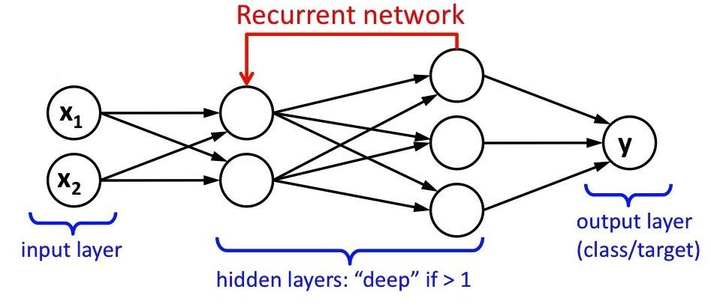
Recurrent Neural Networks (RNN)
Type of NN where output from previous step is fed as Input to current step
Main problem is vanishing gradients so RNN struggle to deal with long sequences

Slide 16
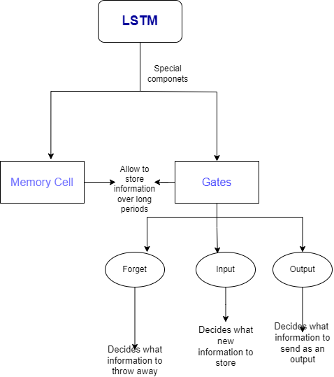
Long Short Term Memory (LSTM)
Designed to fix RNN problem

Slide 17
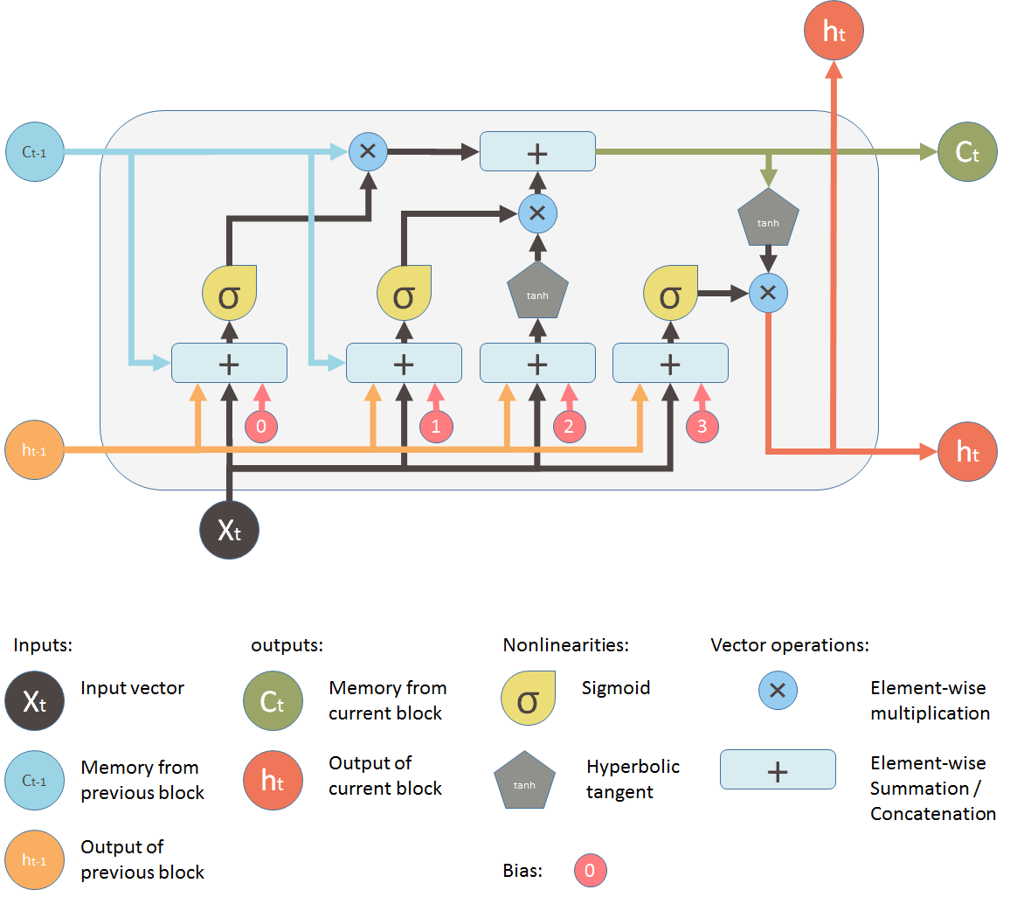
Long Short Term Memory (LSTM)

Slide 18
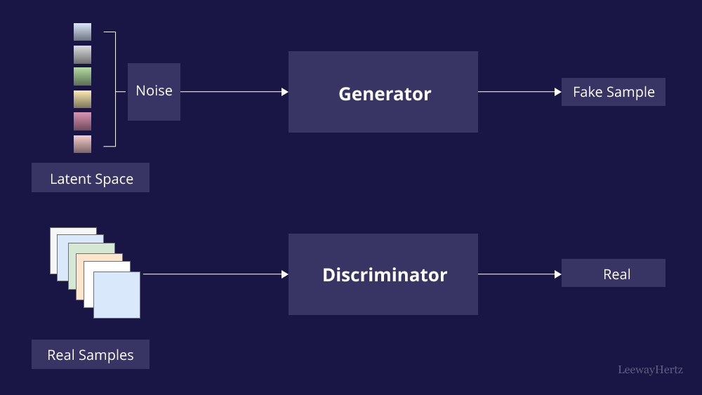
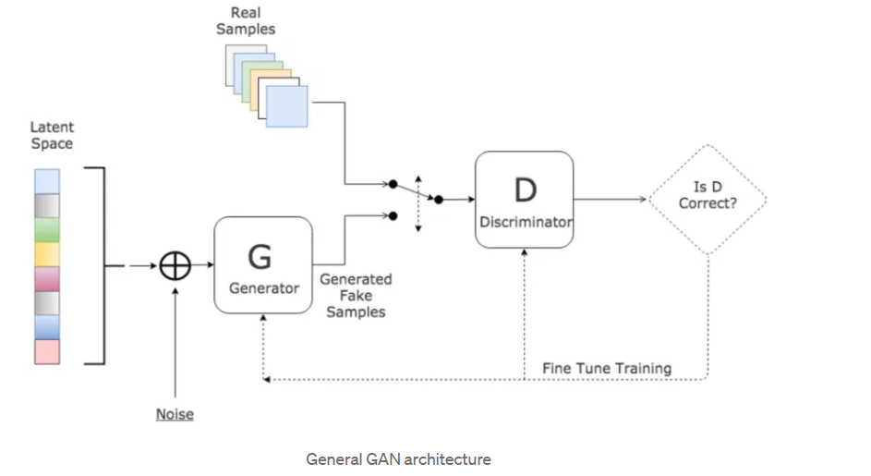
Generative Adversial Networks(GAN)
Type of NN used for unsupervised learning meaning can create data without explicitly told what to generate
Divided into parts Generator (G) and Discriminator(D)
Notes:
This diagram illustrates the general workflow of a Generative Adversarial Network (GAN), involving two main components: the generator (\(G\)) and the discriminator (\(D\)).
1. **Latent Space & Noise Input**:
- The process begins with a random noise vector sampled from a **latent space** (shown on the left). This vector, essentially a random point in the latent space, serves as input for the generator.
- The noise allows the generator to create diverse outputs, so each point in the latent space can correspond to a different generated sample.
2. **Generator**:
- The generator (\(G\)) takes the noise vector and transforms it into a **generated (fake) sample** that resembles a real sample from the training data. If the GAN is trained on images, for example, the generator tries to create an image that looks similar to real images in the dataset.
- The generator's goal is to produce samples that can "fool" the discriminator into thinking they are real.
3. **Discriminator**:
- The discriminator (\(D\)) is a binary classifier that takes both **real samples** (from the actual dataset) and **fake samples** (generated by the generator) as input.
- It attempts to classify each sample as either "real" or "fake." If the input is a real sample from the dataset, \(D\) should output "real"; if the input is a generated sample, \(D\) should output "fake."
- The discriminator’s role is to be a "critic," helping the generator improve over time by providing feedback on how realistic its generated samples are.
4. **Adversarial Training Loop**:
- The **training loop** alternates between the generator and discriminator:
- First, \(D\) is trained on both real and fake samples to improve its ability to distinguish between them.
- Then, \(G\) is trained to generate samples that can fool \(D\) by using feedback from \(D\)’s assessment.
- Over time, \(G\) becomes better at creating realistic samples, while \(D\) becomes better at distinguishing real from fake.
5. **Is \(D\) Correct?**:
- This final step checks whether \(D\) correctly classifies samples as real or fake.
- If \(D\) correctly distinguishes real from fake, \(G\) has to improve further; if \(D\) is "fooled," it signals that \(G\) is producing more realistic samples.
The generator and discriminator are thus in a constant "adversarial" interaction, where they each try to outsmart the other, ultimately resulting in a generator capable of producing highly realistic samples.

Slide 19
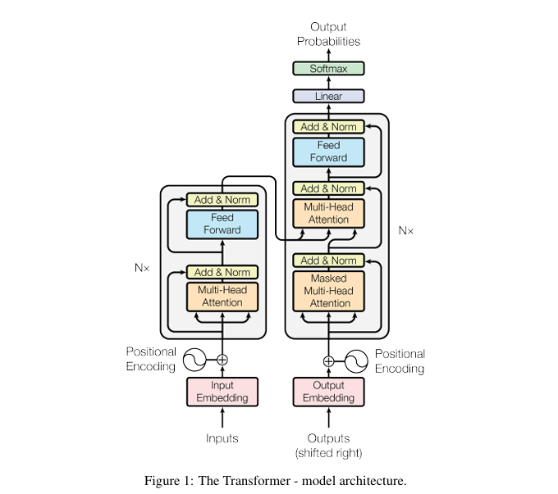
Transformers
Introduced in the 2017 paper "Attention is All You Need" by Google,
Transformers were first developed to solve the problem of sequence transduction, or neural machine translation, which means they are meant to solve any task that transforms an input sequence to an output sequence.
Attention is a mechanism that lets the model focus on relevant parts of an input sequence by assigning different importance weights to each element, enabling it to capture context and relationships effectively.
Notes:
Sure, here’s a quick summary:
1. **Self-Attention Mechanism**: Calculates the relevance of each token in a sequence to every other token to capture context.
2. **Positional Encoding**: Adds information about the order of tokens to allow the model to recognize sequence structure.
3. **Multi-Head Attention**: Uses multiple attention "heads" to capture different types of relationships between tokens in parallel.
4. **Feed-Forward Neural Networks**: Processes the output from the attention layers to generate refined representations.
5. **Layer Normalization and Residual Connections**: Stabilize training by preserving information and ensuring smoother gradients.
6. **Stacking Layers**: Builds a deep network by layering multiple attention and feed-forward blocks to capture complex patterns.
7. **Encoder**: Encodes the input sequence into a high-level representation.
8. **Decoder**: Uses the encoder’s output to generate a new sequence, typically used for tasks like text generation or translation.

Slide 20
Transformers
1. Self-Attention Mechanism: Calculates the relevance of each token in a sequence to every other token to capture context.
2. Positional Encoding: Adds information about the order of tokens to allow the model to recognize sequence structure.
3. Multi-Head Attention: Uses multiple attention "heads" to capture different types of relationships between tokens in parallel.
4. Feed-Forward Neural Networks: Processes the output from the attention layers to generate refined representations.
5. Layer Normalization and Residual Connections: Stabilize training by preserving information and ensuring smoother gradients.
6. Stacking Layers: Builds a deep network by layering multiple attention and feed-forward blocks to capture complex patterns.
7. Encoder: Encodes the input sequence into a high-level representation.
8. Decoder: Uses the encoder’s output to generate a new sequence, typically used for tasks like text generation or translation.
Notes:
Sure, here’s a quick summary:
1. **Self-Attention Mechanism**: Calculates the relevance of each token in a sequence to every other token to capture context.
2. **Positional Encoding**: Adds information about the order of tokens to allow the model to recognize sequence structure.
3. **Multi-Head Attention**: Uses multiple attention "heads" to capture different types of relationships between tokens in parallel.
4. **Feed-Forward Neural Networks**: Processes the output from the attention layers to generate refined representations.
5. **Layer Normalization and Residual Connections**: Stabilize training by preserving information and ensuring smoother gradients.
6. **Stacking Layers**: Builds a deep network by layering multiple attention and feed-forward blocks to capture complex patterns.
7. **Encoder**: Encodes the input sequence into a high-level representation.
8. **Decoder**: Uses the encoder’s output to generate a new sequence, typically used for tasks like text generation or translation.

Slide 21
The shift from RNNs and LSTMs to Transformers
The shift from RNNs and LSTMs to Transformers in NLP was driven by RNNs' slow training due to their sequential processing, which doesn't leverage parallel computing capabilities of GPUs, and their difficulty in maintaining information over long distances in a sequence, whereas Transformers utilize the Attention mechanism to efficiently focus on all parts of the input simultaneously, enhancing both performance and speed.
Notes:
The attention mechanism is a method in neural networks that allows the model to focus on and weigh the significance of different input elements based on their relevance to the task at hand, improving the handling of long-range dependencies in data sequences.

Slide 22
02
Paper 1
Investigation on Automatic Music Generation using GAN & LSTM

Slide 23


Slide 24
1.Abstract
01
02
LSTM
GAN
Trained on music data (midi files)
Focuses on predicting the next note in sequence based on past notes
Generator →Creates new music
Discriminator→Evaluates music sounds real or fake

Slide 25
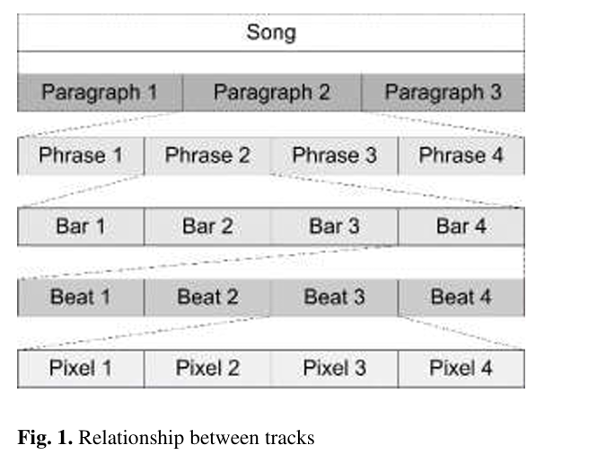
2.Introduction
- Automating music generation is complex due to the need to capture temporal dependency and interactions between multiple musical tracks
- Machine learning models, particularly LSTM and GAN networks, offer potential solutions by creating music based on patterns in a training dataset
- Figure illustrates how these models must account for the interdependence of tracks, which challenges achieving realistic and harmonious music generation
Notes:
Music as Structured Data:
In music, there are hierarchical layers similar to text:
Song (overall structure),
Paragraph (sections of the song, like verses or choruses),
Phrase (musical ideas within sections),
Bar (musical measures),
Beat (small rhythmic units within a bar),
Pixel (even smaller subdivisions, akin to individual notes or sound samples).

Slide 26
3.Problem
This paper addresses the challenge of generating continuous, harmonically pleasing music using AI, with issues like occasional breaks in the melody and temporal dependencies requiring improved training accuracy and larger datasets.
Notes:
Music as Structured Data:
In music, there are hierarchical layers similar to text:
Song (overall structure),
Paragraph (sections of the song, like verses or choruses),
Phrase (musical ideas within sections),
Bar (musical measures),
Beat (small rhythmic units within a bar),
Pixel (even smaller subdivisions, akin to individual notes or sound samples).

Slide 27
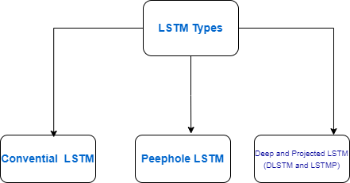
4.Architecture of LSTM and its Variants
Notes:
Memory in LSTM (Long Short-Term Memory) networks is crucial because it allows the model to retain and utilize information from previous time steps, effectively capturing long-term dependencies in sequential data.

Slide 28
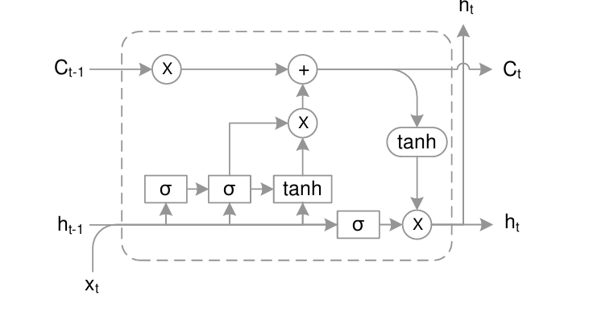
4.1.Convential LSTM
Notes:
Music as Structured Data:
In music, there are hierarchical layers similar to text:
Song (overall structure),
Paragraph (sections of the song, like verses or choruses),
Phrase (musical ideas within sections),
Bar (musical measures),
Beat (small rhythmic units within a bar),
Pixel (even smaller subdivisions, akin to individual notes or sound samples).

Slide 29
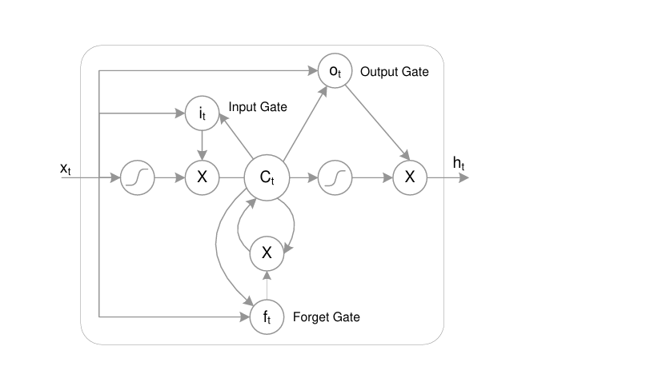
4.2.Peephole LSTM
Notes:
Music as Structured Data:
In music, there are hierarchical layers similar to text:
Song (overall structure),
Paragraph (sections of the song, like verses or choruses),
Phrase (musical ideas within sections),
Bar (musical measures),
Beat (small rhythmic units within a bar),
Pixel (even smaller subdivisions, akin to individual notes or sound samples).

Slide 30
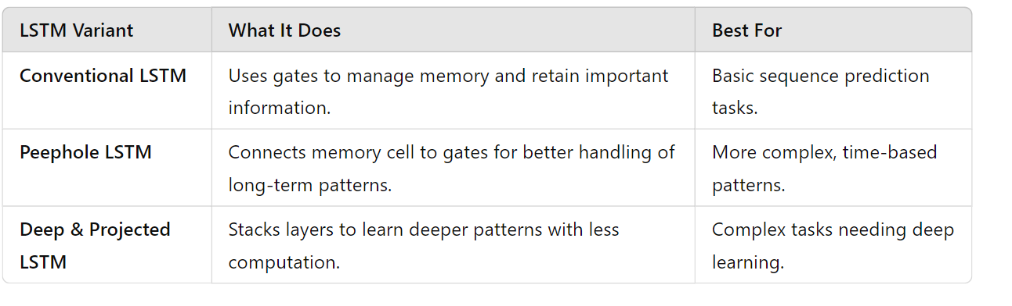
Difference Between Each Type
Notes:
Music as Structured Data:
In music, there are hierarchical layers similar to text:
Song (overall structure),
Paragraph (sections of the song, like verses or choruses),
Phrase (musical ideas within sections),
Bar (musical measures),
Beat (small rhythmic units within a bar),
Pixel (even smaller subdivisions, akin to individual notes or sound samples).

Slide 31
5.GAN
Notes:
Here’s a clearer explanation:
- Use **jamming models** in GANs for generating diverse outputs by combining multiple GANs, especially useful with large datasets.
- Use **composer models** when you need modular generation, allowing specific parts of the output to be controlled or composed.
- Use **hybrid models** when you want to combine GANs with other types of models (like VAEs or supervised models) for tasks that need both generation and feature learning.

Slide 32
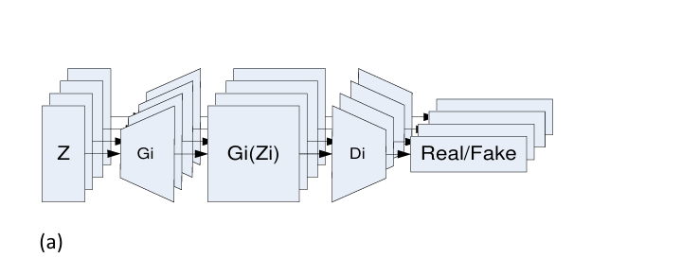
5.1.Jamming Model
Has N Generators
&
N Discriminators
For generating
N Tracks
Notes:
Music as Structured Data:
In music, there are hierarchical layers similar to text:
Song (overall structure),
Paragraph (sections of the song, like verses or choruses),
Phrase (musical ideas within sections),
Bar (musical measures),
Beat (small rhythmic units within a bar),
Pixel (even smaller subdivisions, akin to individual notes or sound samples).

Slide 33
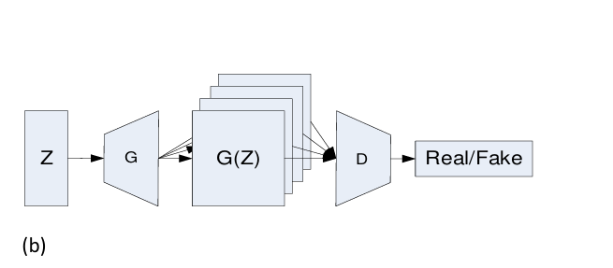
5.2.Composer Model
Has single generator and one discriminator to mimic a single composer creating several piano rolls
Notes:
Music as Structured Data:
In music, there are hierarchical layers similar to text:
Song (overall structure),
Paragraph (sections of the song, like verses or choruses),
Phrase (musical ideas within sections),
Bar (musical measures),
Beat (small rhythmic units within a bar),
Pixel (even smaller subdivisions, akin to individual notes or sound samples).

Slide 34
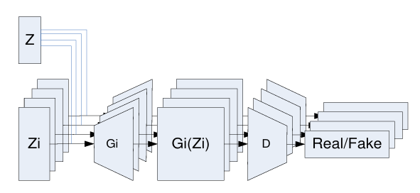
5.3.Hybrid Model
Has M Generator and N Discriminator
Notes:
Music as Structured Data:
In music, there are hierarchical layers similar to text:
Song (overall structure),
Paragraph (sections of the song, like verses or choruses),
Phrase (musical ideas within sections),
Bar (musical measures),
Beat (small rhythmic units within a bar),
Pixel (even smaller subdivisions, akin to individual notes or sound samples).

Slide 35

6.Materials and Methods
Notes:
Music as Structured Data:
In music, there are hierarchical layers similar to text:
Song (overall structure),
Paragraph (sections of the song, like verses or choruses),
Phrase (musical ideas within sections),
Bar (musical measures),
Beat (small rhythmic units within a bar),
Pixel (even smaller subdivisions, akin to individual notes or sound samples).

Slide 36
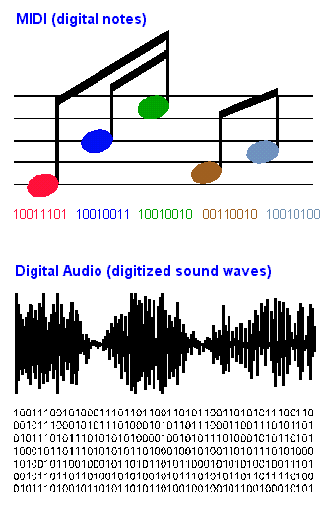
6.1.Midi Format
Widely used by electronic instruments and software drivers
Has Notes and Blanks
Main drawback is in encoding multiple tracks and saving the intention of multiple notes which reduces effectiveness in terms of usage
Overcome this difficulty is the piano roll
Notes:
Music as Structured Data:
In music, there are hierarchical layers similar to text:
Song (overall structure),
Paragraph (sections of the song, like verses or choruses),
Phrase (musical ideas within sections),
Bar (musical measures),
Beat (small rhythmic units within a bar),
Pixel (even smaller subdivisions, akin to individual notes or sound samples).

Slide 37
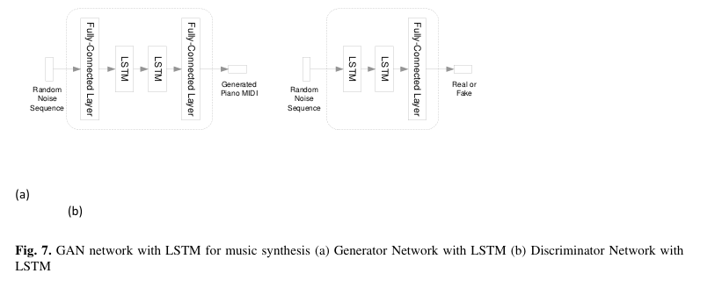
6.2.Conditional GAN Model
LSTM has been used to synthesize music
Generator has LSTM cell depending on number of notes(e.g. sequence has 10 notes, generator requires 10 LSTM for learning)
Discriminator has LSTM and helps to differentiate generated music from real one
Notes:
Music as Structured Data:
In music, there are hierarchical layers similar to text:
Song (overall structure),
Paragraph (sections of the song, like verses or choruses),
Phrase (musical ideas within sections),
Bar (musical measures),
Beat (small rhythmic units within a bar),
Pixel (even smaller subdivisions, akin to individual notes or sound samples).

Slide 38
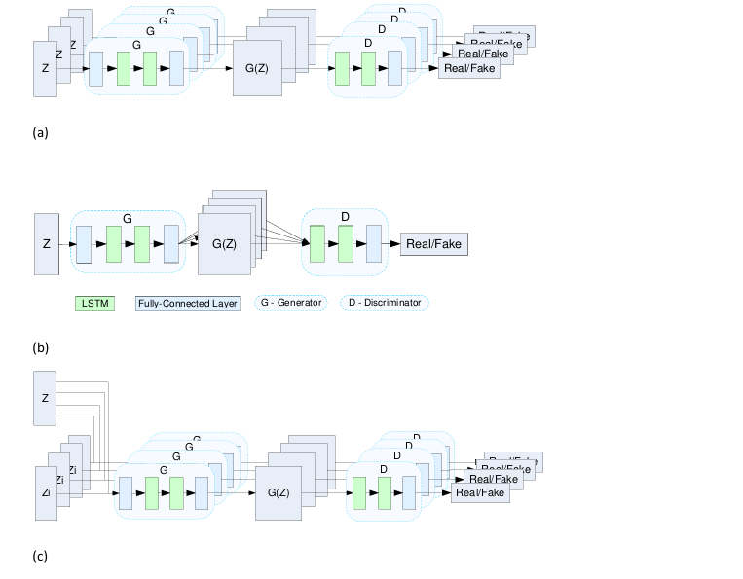
6.3.Music Synthesizer Using Conditional GAN
Incorporating a conditional GAN into the music synthesizer enhances temporal coherence by conditioning the music generation process on specific features, ensuring the generated sequences flow naturally over time.
Notes:
Music as Structured Data:
In music, there are hierarchical layers similar to text:
Song (overall structure),
Paragraph (sections of the song, like verses or choruses),
Phrase (musical ideas within sections),
Bar (musical measures),
Beat (small rhythmic units within a bar),
Pixel (even smaller subdivisions, akin to individual notes or sound samples).

Slide 39
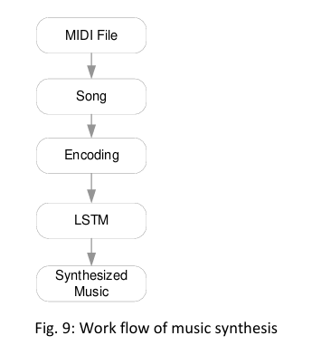
7.Workflow
Notes:
Music as Structured Data:
In music, there are hierarchical layers similar to text:
Song (overall structure),
Paragraph (sections of the song, like verses or choruses),
Phrase (musical ideas within sections),
Bar (musical measures),
Beat (small rhythmic units within a bar),
Pixel (even smaller subdivisions, akin to individual notes or sound samples).

Slide 40
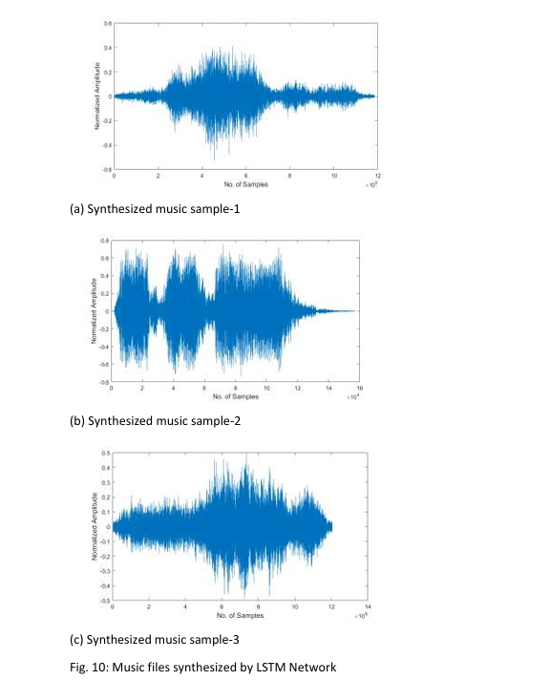
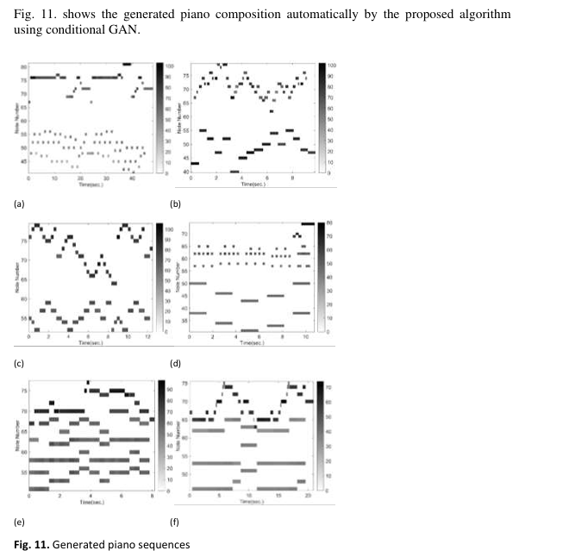
8.Experiments and Results
Simulation Results
Generated Piano Rolls
Notes:
Music as Structured Data:
In music, there are hierarchical layers similar to text:
Song (overall structure),
Paragraph (sections of the song, like verses or choruses),
Phrase (musical ideas within sections),
Bar (musical measures),
Beat (small rhythmic units within a bar),
Pixel (even smaller subdivisions, akin to individual notes or sound samples).

Slide 41
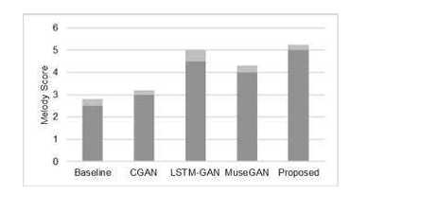
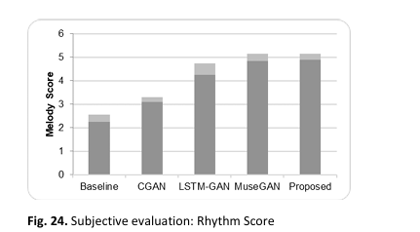
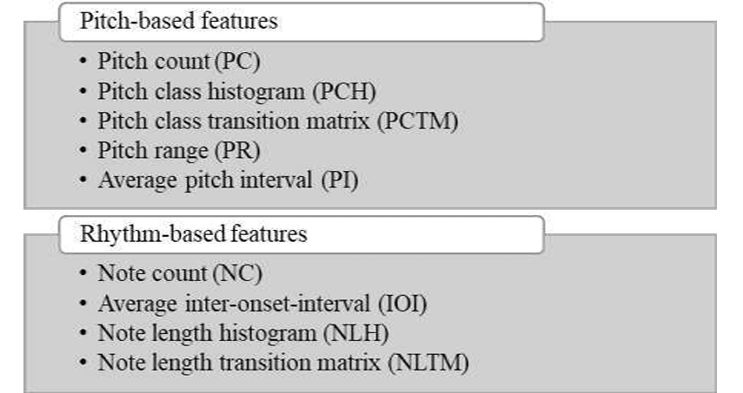
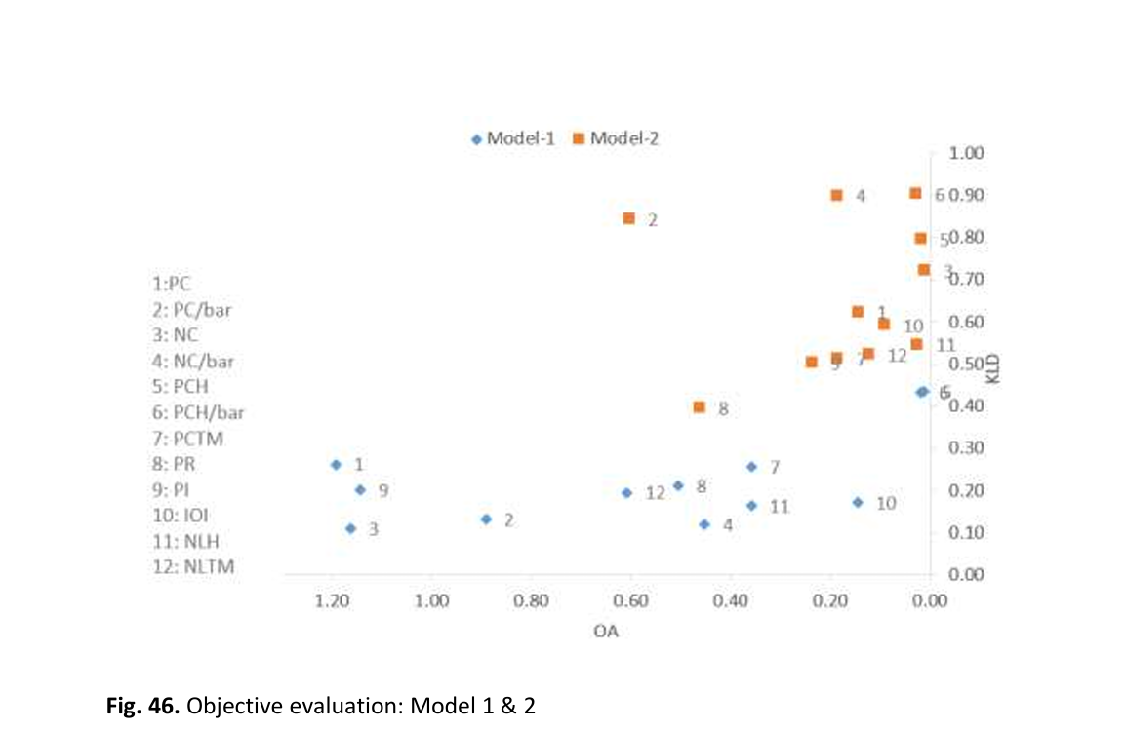
9.Evaluation of Models
Notes:
Music as Structured Data:
In music, there are hierarchical layers similar to text:
Song (overall structure),
Paragraph (sections of the song, like verses or choruses),
Phrase (musical ideas within sections),
Bar (musical measures),
Beat (small rhythmic units within a bar),
Pixel (even smaller subdivisions, akin to individual notes or sound samples).

Slide 42
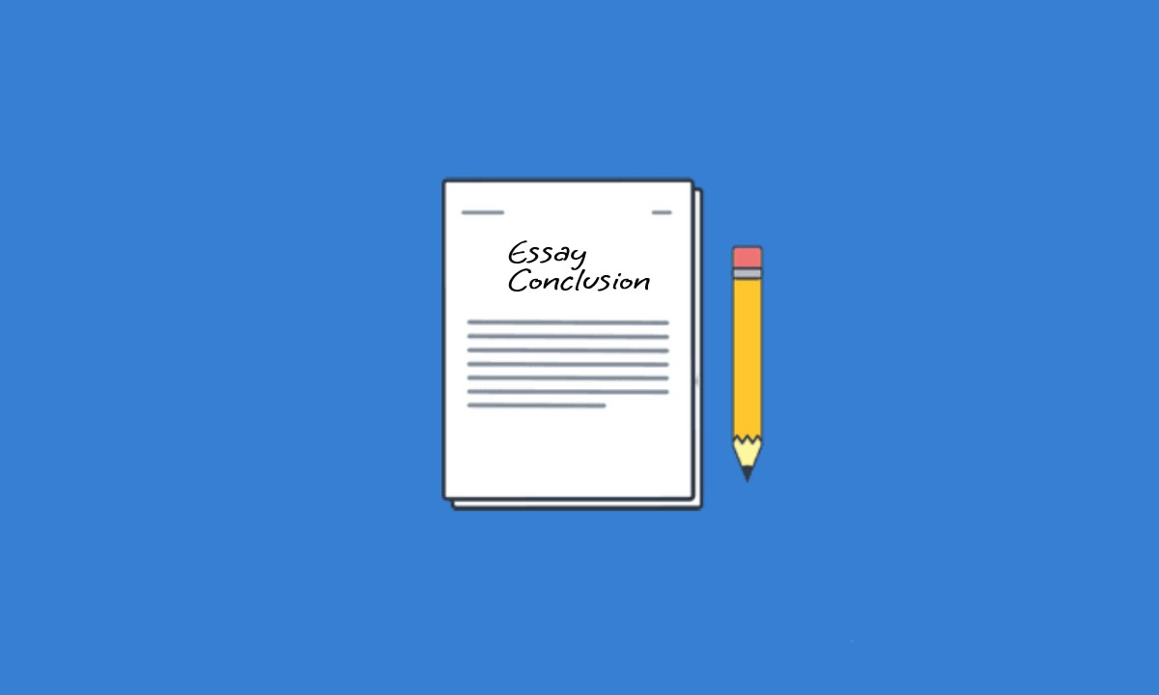
10.Conclusion
The AI model using LSTM and GAN networks successfully generated harmonically similar music with mostly smooth sequences, but occasional breaks in the notes suggest a need for better training accuracy and more data.
Notes:
Music as Structured Data:
In music, there are hierarchical layers similar to text:
Song (overall structure),
Paragraph (sections of the song, like verses or choruses),
Phrase (musical ideas within sections),
Bar (musical measures),
Beat (small rhythmic units within a bar),
Pixel (even smaller subdivisions, akin to individual notes or sound samples).

Slide 43
02
Paper 2
Bridging Paintings and Music-Exploring Emotion based Music Generation through Paintings

Slide 44
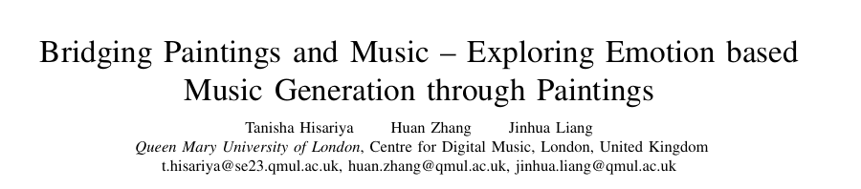

Slide 45
1.Objective
Presents a model that generates music based on the emotions in paintings by using emotion labeling, image captioning, and language models
Creating a dataset of paired artworks and music
Evaluating performance through various audio similarity metrics.
Notes:
Music as Structured Data:
In music, there are hierarchical layers similar to text:
Song (overall structure),
Paragraph (sections of the song, like verses or choruses),
Phrase (musical ideas within sections),
Bar (musical measures),
Beat (small rhythmic units within a bar),
Pixel (even smaller subdivisions, akin to individual notes or sound samples).

Slide 46
2.Introduction
This research introduces a model that generates music based on the emotions in paintings by using a two-stage process to convert images to text and then to music, leveraging a new dataset and multiple evaluation metrics to enhance accessibility, learning, and therapeutic applications.
Notes:
Music as Structured Data:
In music, there are hierarchical layers similar to text:
Song (overall structure),
Paragraph (sections of the song, like verses or choruses),
Phrase (musical ideas within sections),
Bar (musical measures),
Beat (small rhythmic units within a bar),
Pixel (even smaller subdivisions, akin to individual notes or sound samples).

Slide 47
3.Problem
The main problem the paper addresses is the challenge of translating emotions from visual art, specifically paintings, into music. This involves creating a system that can recognize the emotional content in an image and generate a corresponding musical composition, despite limited datasets that align visual art with music.
Notes:
Music as Structured Data:
In music, there are hierarchical layers similar to text:
Song (overall structure),
Paragraph (sections of the song, like verses or choruses),
Phrase (musical ideas within sections),
Bar (musical measures),
Beat (small rhythmic units within a bar),
Pixel (even smaller subdivisions, akin to individual notes or sound samples).

Slide 48
4.Related Work
Research covers three key area in Generative AI
1)Image Feature Extraction & Conversion
2)Deep Learning Techniques for Music Generation
3)Multi Modality in Music Generation
Notes:
Music as Structured Data:
In music, there are hierarchical layers similar to text:
Song (overall structure),
Paragraph (sections of the song, like verses or choruses),
Phrase (musical ideas within sections),
Bar (musical measures),
Beat (small rhythmic units within a bar),
Pixel (even smaller subdivisions, akin to individual notes or sound samples).

Slide 49
4.1.Image Feature Extraction and Conversion
Image feature extraction can be performed through unimodal methods, which classify images with single labels, or multimodal methods, which combine visual and textual data for richer descriptions.
The development of models like CLIP and BLIP has significantly improved image captioning by aligning visual information with language, integrating a flexible multimodal encoder-decoder framework that excelled in both understanding & generating visual-language tasks with high accuracy .
Notes:
Music as Structured Data:
In music, there are hierarchical layers similar to text:
Song (overall structure),
Paragraph (sections of the song, like verses or choruses),
Phrase (musical ideas within sections),
Bar (musical measures),
Beat (small rhythmic units within a bar),
Pixel (even smaller subdivisions, akin to individual notes or sound samples).

Slide 50
4.2.Deep Learning Methods for Music Generation
1.RNNs (Recurrent Neural Networks): Were the first to be used for generating musical sequences, but they struggled with retaining long-term memory, limiting their effectiveness for coherent music over time.
2. LSTMs (Long Short-Term Memory networks): Improved on RNNs by enhancing the model's memory capacity, allowing it to retain musical sequences over longer periods and produce more cohesive compositions.
3. RBMs (Restricted Boltzmann Machines): Were explored for melody generation, though they faced challenges with maintaining long-term coherence in musical structure.
4. CNNs, VAEs, and GANs: Convolutional Neural Networks (CNNs), Variational Autoencoders (VAEs), and GANs (Generative Adversarial Networks) enabled multi-track and symbolic music generation, with models like MuseGAN achieving realistic multi-instrument compositions.
Notes:
A Restricted Boltzmann Machine (RBM) is a type of neural network used for unsupervised learning that models the probability distribution of inputs and captures patterns, often applied in tasks like dimensionality reduction, feature learning, and, in early work, melody generation.

Slide 51
4.2.Deep Learning Methods for Music Generation
5. WaveNet: As a CNN-based autoregressive model, WaveNet introduced raw audio generation by producing continuous sound rather than symbolic notes, resulting in more natural-sounding music.
6. Transformers: As seen in models like Music Transformer and MuseNet, excel at capturing long-term patterns in music, allowing for more complex and extended compositions, although they are computationally intensive.
7. Emotion-based Conditional Models: Like Conditional VAEs and recent models such as AudioLDM, generate music based on specified emotions or themes, aligning music with visual or text-based emotional cues.
Notes:
A Restricted Boltzmann Machine (RBM) is a type of neural network used for unsupervised learning that models the probability distribution of inputs and captures patterns, often applied in tasks like dimensionality reduction, feature learning, and, in early work, melody generation.

Slide 52
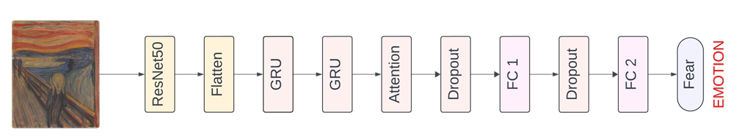
4.3.Muli-Modality Audio and Music Generation
Recent multimodal music generation models like cMelGAN, JukePix, and AudioLDM integrate text, audio, and visual inputs to produce high-quality, emotion-driven music, though they face challenges with data requirements and computational efficiency.
Notes:
In this neural network architecture, here's how each layer functions in brief:
1. **ResNet50**: Extracts high-level features from the input image using a pre-trained convolutional neural network.
2. **Flatten**: Converts the 3D output from ResNet50 into a 1D vector.
3. **GRU** (first and second): Processes the sequential data from the image features to capture temporal patterns.
4. **Attention**: Focuses on the most important parts of the GRU output to enhance relevant features.
5. **Dropout** (first and second): Reduces overfitting by randomly setting some inputs to zero during training.
6. **Fully Connected Layer (FC 1 and FC 2)**: Performs dense operations to further process the features for classification.
7. **Output Layer (Emotion)**: Classifies the image into an emotion category (like "Fear") based on the processed features.
Let me know if you'd like more details on any specific layer!

Slide 53
5.Method
Image
convert
Text
Fine tune
Music
Notes:
Music as Structured Data:
In music, there are hierarchical layers similar to text:
Song (overall structure),
Paragraph (sections of the song, like verses or choruses),
Phrase (musical ideas within sections),
Bar (musical measures),
Beat (small rhythmic units within a bar),
Pixel (even smaller subdivisions, akin to individual notes or sound samples).

Slide 54
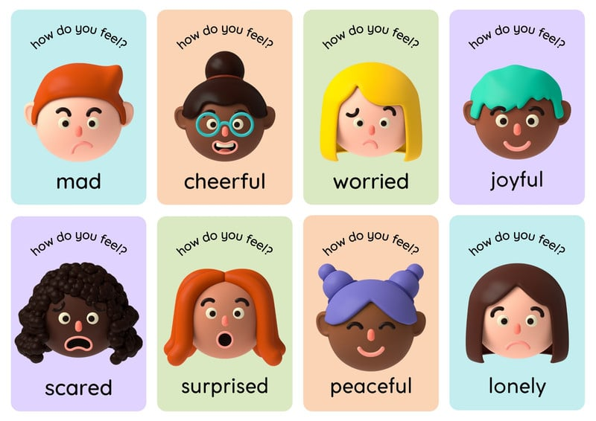
5.1.Image Emotion Labelling Model
The Image Emotion Labeling Model uses a pre-trained ResNet50 with added GRU and Attention layers to classify emotions in images, leveraging transfer learning for accuracy and incorporating dropout to prevent overfitting.
Notes:
Music as Structured Data:
In music, there are hierarchical layers similar to text:
Song (overall structure),
Paragraph (sections of the song, like verses or choruses),
Phrase (musical ideas within sections),
Bar (musical measures),
Beat (small rhythmic units within a bar),
Pixel (even smaller subdivisions, akin to individual notes or sound samples).

Slide 55

5.2.Image Description Model
The Image Description Model, using the BLIP model, generates captions that reflect the emotions perceived in images by conditioning on emotion labels, ensuring the captions are both descriptive and emotionally relevant.
Notes:
Music as Structured Data:
In music, there are hierarchical layers similar to text:
Song (overall structure),
Paragraph (sections of the song, like verses or choruses),
Phrase (musical ideas within sections),
Bar (musical measures),
Beat (small rhythmic units within a bar),
Pixel (even smaller subdivisions, akin to individual notes or sound samples).

Slide 56
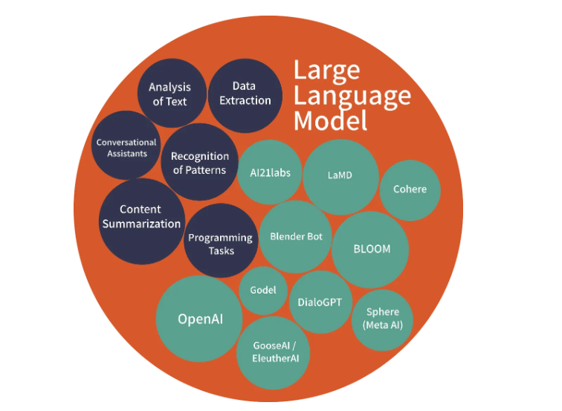
5.3.Large Language Model (LLM)
Is an advanced type of AI model based on transformer architectures trained on massive datasets of text to understand and generate human-like language.
In paper used to enrich image descriptions by adding musical terms that align with the emotions and themes present in the image.
The LLM model, specifically FalconRW-1B, enhances image captions by adding musical terms (e.g., mood, genre, tempo) to make descriptions more suitable for music generation, ensuring emotional accuracy while requiring minimal computational resources.
Notes:
Music as Structured Data:
In music, there are hierarchical layers similar to text:
Song (overall structure),
Paragraph (sections of the song, like verses or choruses),
Phrase (musical ideas within sections),
Bar (musical measures),
Beat (small rhythmic units within a bar),
Pixel (even smaller subdivisions, akin to individual notes or sound samples).

Slide 57
5.4.Music Generation
The MusicGen-small model(MG-S) was fine tuned for generating music based on various textual inputs derived from corresponding image to text model & audio files.
Text & audio files encoded-→token using specialized encoder models -→conditioning &Fusion process (involving Attention mechanism)
Then was processed by a Transformer model
Notes:
Music as Structured Data:
In music, there are hierarchical layers similar to text:
Song (overall structure),
Paragraph (sections of the song, like verses or choruses),
Phrase (musical ideas within sections),
Bar (musical measures),
Beat (small rhythmic units within a bar),
Pixel (even smaller subdivisions, akin to individual notes or sound samples).

Slide 58
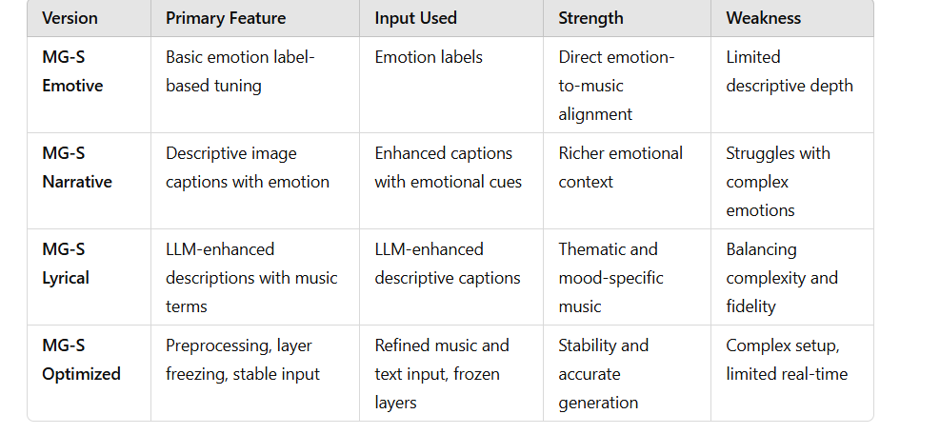
5.4.Music Generation
Several Iterations of MG-S
Notes:
Music as Structured Data:
In music, there are hierarchical layers similar to text:
Song (overall structure),
Paragraph (sections of the song, like verses or choruses),
Phrase (musical ideas within sections),
Bar (musical measures),
Beat (small rhythmic units within a bar),
Pixel (even smaller subdivisions, akin to individual notes or sound samples).

Slide 59
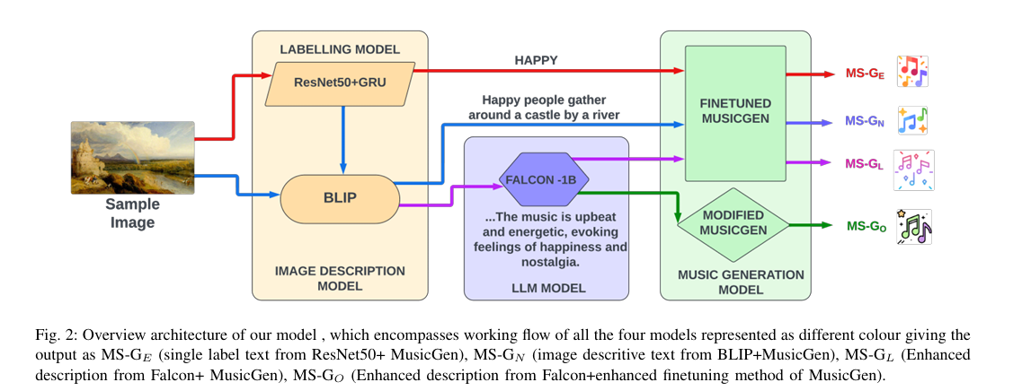
5.5.Architechture
Notes:
Music as Structured Data:
In music, there are hierarchical layers similar to text:
Song (overall structure),
Paragraph (sections of the song, like verses or choruses),
Phrase (musical ideas within sections),
Bar (musical measures),
Beat (small rhythmic units within a bar),
Pixel (even smaller subdivisions, akin to individual notes or sound samples).

Slide 60
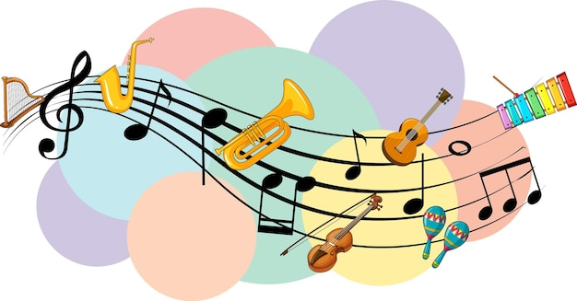
6.Experiments
Notes:
Music as Structured Data:
In music, there are hierarchical layers similar to text:
Song (overall structure),
Paragraph (sections of the song, like verses or choruses),
Phrase (musical ideas within sections),
Bar (musical measures),
Beat (small rhythmic units within a bar),
Pixel (even smaller subdivisions, akin to individual notes or sound samples).

Slide 61
6.1.Datasets
WikiArt Emotion Dataset: An open-source collection of paintings from various art periods, categorized by emotions; paper selected 1,200 paintings representing five emotions (Happy, Angry, Sad, Fun, and Neutral) for this project.
MIREX Emotion Dataset: A dataset of 193 MIDI music files expressing various emotions, which we preprocessed into 30-second WAV segments and categorized by the same five emotions to align with our painting dataset.
Notes:
Yes, the WikiArt and MIREX datasets were combined to create a paired dataset, with each painting matched to a music piece that conveys the same emotion.

Slide 62
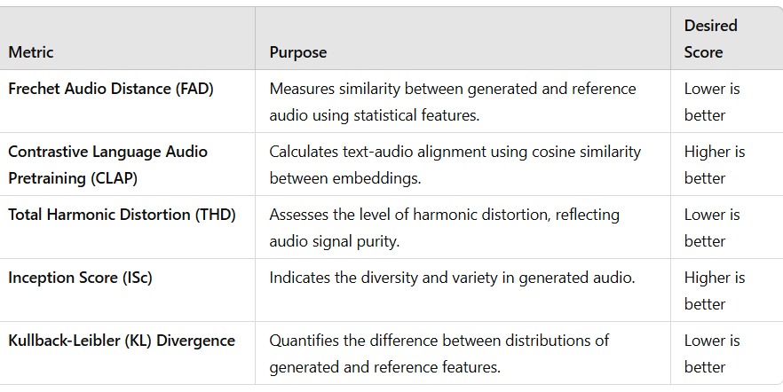
6.2.Evaluation Metrics
Notes:
Yes, the WikiArt and MIREX datasets were combined to create a paired dataset, with each painting matched to a music piece that conveys the same emotion.

Slide 63
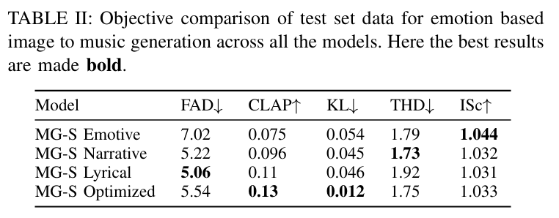
Notes:
Music as Structured Data:
In music, there are hierarchical layers similar to text:
Song (overall structure),
Paragraph (sections of the song, like verses or choruses),
Phrase (musical ideas within sections),
Bar (musical measures),
Beat (small rhythmic units within a bar),
Pixel (even smaller subdivisions, akin to individual notes or sound samples).

Slide 64
6.3.Training and Results
01
02
Training
Results
Conducted on an NVIDIA A40 GPU with a batch size of 16, using the small MusicGen model for 40 epochs, with an AdamW optimizer, a learning rate of 1e-5, and a cosine scheduler.
The MG-S Optimized model showed the best performance among four MusicGen variants, achieving the highest CLAP scores and lowest noise and distortion, indicating superior alignment between generated music and complex emotional descriptions.

Slide 65
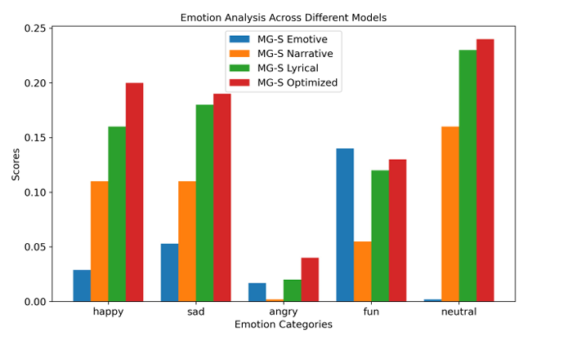

Slide 66
7.Conclusion
The conclusion highlights that the generative model successfully creates music based on the emotions in paintings, but it also identifies challenges such as limited datasets, differences between model outputs and user expectations, high inference times, and the need for specialized evaluation metrics, all of which must be addressed to enhance future multimodal art generation efforts.
Notes:
Music as Structured Data:
In music, there are hierarchical layers similar to text:
Song (overall structure),
Paragraph (sections of the song, like verses or choruses),
Phrase (musical ideas within sections),
Bar (musical measures),
Beat (small rhythmic units within a bar),
Pixel (even smaller subdivisions, akin to individual notes or sound samples).

Slide 67
03
Paper 3
Symbolic Music Generation with Transformer-GANs

Slide 68
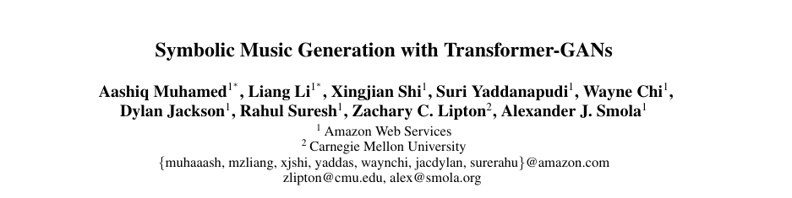

Slide 69
1.Objective
Improve the quality of long music compositions generated by autoregressive models by incorporating adversarial losses, thereby reducing the effects of exposure bias and achieving better performance than traditional likelihood maximization methods.
Notes:
Music as Structured Data:
In music, there are hierarchical layers similar to text:
Song (overall structure),
Paragraph (sections of the song, like verses or choruses),
Phrase (musical ideas within sections),
Bar (musical measures),
Beat (small rhythmic units within a bar),
Pixel (even smaller subdivisions, akin to individual notes or sound samples).

Slide 70
2.Problem
The paper addresses the problem of exposure bias in autoregressive music generation models, which leads to a significant degradation in the quality of samples for long sequences.
Notes:
Exposure bias is a phenomenon in machine learning, particularly in sequence generation tasks, where a model performs well during training because it learns from the true data distribution but struggles during inference because it relies on its own predictions rather than the actual data. This discrepancy can cause the quality of generated outputs to degrade, especially in longer sequences, as errors compound over time.
Exposure bias occurs when a model is trained on the actual data but must generate sequences using its own previous outputs during inference, which can lead to lower quality results, especially in longer sequences.

Slide 71
3.Related Work
Historical Evolution: Sequence generative models have progressed from traditional methods like n-grams to neural architectures, with Transformers now leading in music generation.
Challenges with Autoregressive Models: Autoregressive models such as the Music Transformer struggle with exposure bias, which leads to compounded prediction errors in longer sequences.
GANs and Sequence Generation: GANs face difficulties in sequence generation due to instability and mode collapse, prompting the use of techniques like Gumbel-Softmax to enhance the sampling process.
Notes:
Recent methods combine GANs with Transformers to enhance the generation of long, high-quality music sequences by utilizing Transformers for generation and advanced discriminators for improved stability during training.

Slide 72
4.Methdology
Notes:
Recent methods combine GANs with Transformers to enhance the generation of long, high-quality music sequences by utilizing Transformers for generation and advanced discriminators for improved stability during training.

Slide 73
4.1.Data Representation
The data representation for training generative models utilizes a language-modeling approach with a vocabulary that includes 88 NOTE ON events, 88 NOTE OFF events, 100 TIME SHIFTs, and 32 VELOCITY bins, enabling precise timing and dynamic expression in music generation.
Notes:
Recent methods combine GANs with Transformers to enhance the generation of long, high-quality music sequences by utilizing Transformers for generation and advanced discriminators for improved stability during training.

Slide 74
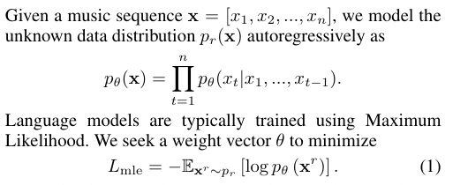
4.2.Maximum Likelihood
Maximum likelihood training aims to model the data distribution of music sequences in a sequential manner by minimizing the negative log-likelihood of the observed sequences, but it is limited by issues such as model misspecification and exposure bias, which can lead to amplified errors and poor-quality outputs.
Notes:
Recent methods combine GANs with Transformers to enhance the generation of long, high-quality music sequences by utilizing Transformers for generation and advanced discriminators for improved stability during training.

Slide 75
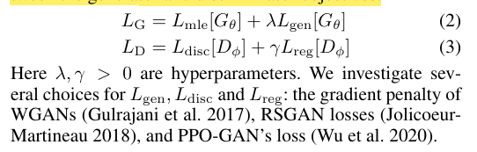
4.3.Adversial Loses
Are a type of loss function used in Generative Adversarial Networks (GANs) where the generator and discriminator are trained in opposition to each other, with the generator aiming to produce realistic outputs that can fool the discriminator, while the discriminator attempts to distinguish between real and generated data.
The discriminator is implemented using a pretrained BERT model on music data, and regularization is applied to prevent overfitting, with training involving alternating updates between the generator and discriminator objectives.
Notes:
Recent methods combine GANs with Transformers to enhance the generation of long, high-quality music sequences by utilizing Transformers for generation and advanced discriminators for improved stability during training.

Slide 76
4.3.1.WGAN with Gradient Penalty Loss
Wasserstein Generative Adversarial Network (WGAN) is a type of GAN that improves training stability and reduces mode collapse by using the Wasserstein distance as a loss metric, enabling better assessment of the difference between the real and generated data distributions.
The RSGAN loss defines the effective discriminator to estimate the likelihood that real data is more realistic than fake data, guiding the generator and discriminator through respective optimization objectives.
The PPO-GAN loss incorporates a KL divergence penalty while treating the generator as a policy and the discriminator as a reward function, ensuring consistency with previous generator distributions and enforcing Lipschitz continuity with gradient penalties.
Notes:
Recent methods combine GANs with Transformers to enhance the generation of long, high-quality music sequences by utilizing Transformers for generation and advanced discriminators for improved stability during training.

Slide 77
4.4.Transformer GAN Architechture
Generator
Discriminator
Transformer-XL is used to model long-range dependencies by reusing hidden states from previous segments, thereby enabling effective memory utilization.
BERT model is used to extract sequence embeddings and stabilize training by providing informative gradients, while employing transfer learning techniques such as freezing lower layers to focus on fine-tuning the upper layers for classifying real and generated music sequences.
Notes:
Recent methods combine GANs with Transformers to enhance the generation of long, high-quality music sequences by utilizing Transformers for generation and advanced discriminators for improved stability during training.

Slide 78
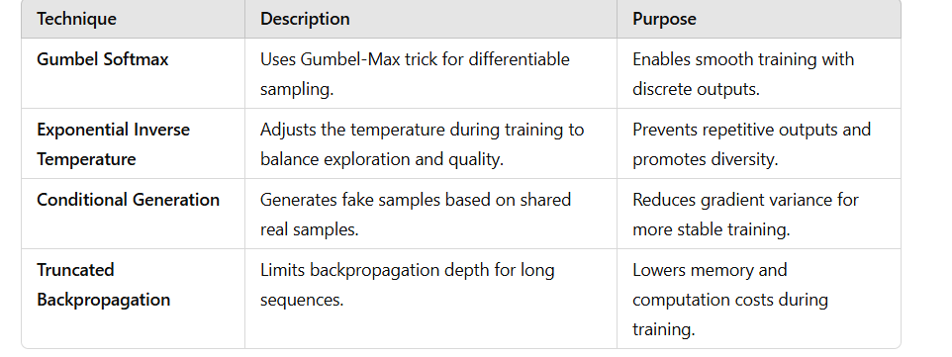
4.5.Tricks of Adversarial Trainig
Notes:
### Gumbel Softmax
The Gumbel-Softmax trick allows for differentiable sampling from discrete distributions by reparameterizing the sampling process, enabling effective backpropagation while generating sequences for the discriminator.
### Exponential Inverse Temperature
Using an exponential decay policy for the inverse temperature during GAN training helps mitigate mode collapse by balancing exploration and exploitation, encouraging diversity in generated samples.
### Conditional Generation
Applying conditional sampling reduces variance in gradient estimation by ensuring that both real and fake samples share a common priming sequence, leading to more stable training of the generator.
### Truncated Backpropagation Through Time (TBPTT)
TBPTT efficiently handles the long sequences generated by the model by limiting the backpropagation depth, thus reducing the computational and memory demands associated with standard backpropagation through time.

Slide 79
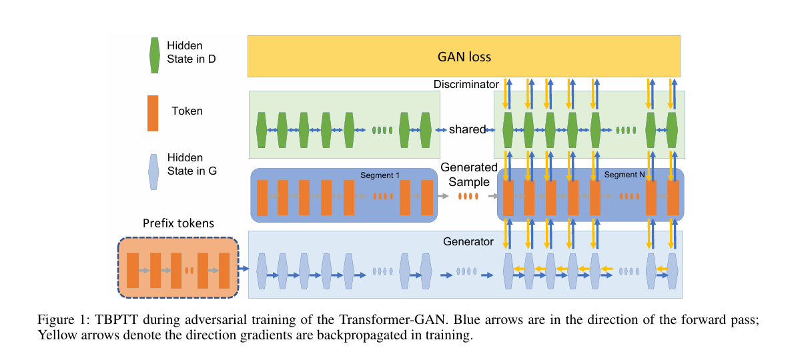

Slide 80
Gradient Penalty
To stabilize GAN training and address issues with the discriminator overpowering the generator and gradient problems, a gradient penalty regularizer is implemented by interpolating real and fake token sequences in embedding space, which proves more effective than traditional methods like layer normalization and dropout.
Notes:
### Gradient Penalty Summary
**Overview:** To stabilize GAN training, particularly due to issues like the discriminator overpowering the generator and gradient problems, a gradient penalty regularizer is introduced.
- **Motivation:** The discriminator can reach optimal performance quickly, leading to exploding or vanishing gradients.
- **Implementation:** Each token sequence \(\hat{x}\) is formed by interpolating between real and fake tokens in embedding space using the formula:
\[
\hat{x}_t = \alpha \text{embed}[x_{r_t}] + (1 - \alpha) \text{embed}[x_{f_t}]
\]
where \(\alpha\) is sampled uniformly from (0, 1).
- **Findings:** The gradient penalty regularizer proves more effective for stabilizing training compared to other methods like layer normalization, dropout, and L2 weight decay, aligning with findings from previous studies on image GANs.

Slide 81
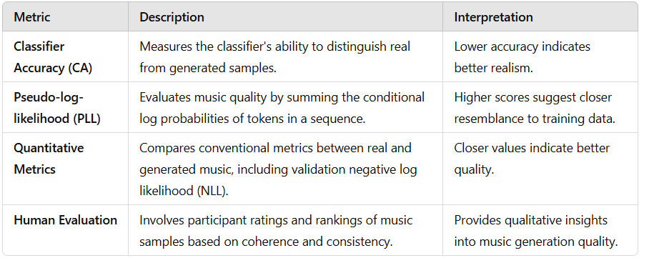
5.Metrics
Notes:
- **Classifier Accuracy (CA)**: This metric measures the realism of generated music by evaluating a classifier's ability to distinguish between real and generated samples, with lower accuracy indicating better alignment with real data distributions.
- **Pseudo-log-likelihood (PLL)**: Derived from the Masked Language Model objective, this score assesses the quality of music by summing the conditional log probabilities of each token in a sequence, with higher scores indicating closer resemblance to the training set.
- **Quantitative Metrics**: Conventional objective metrics evaluate the generated music by comparing its values to those of real training data, with closer alignment suggesting higher quality, while also reporting validation negative log likelihood (NLL) across generated samples.
- **Human Evaluation**: Participants rate and rank generated music samples based on coherence and consistency in response to predefined priming sequences, providing qualitative insights into the model's performance.

Slide 82
6.Implementation Details
The models are evaluated using the MAESTRO MIDI V1 dataset, which includes over 200 hours of audio and MIDI recordings, split into training, validation, and evaluation sets, with data augmentation techniques involving pitch transposition and time stretching applied as in the Music Transformer.
The Transformer-XL is set with a 0.004 initial learning rate, inverse square root scheduler, and Adam optimizer, targeting a sequence length of 128 to balance training time and performance.
Memory length is 1024 for training and 2048 for evaluation, with a reset feature at the start of each MIDI file, impacting NLL and music quality.
GANs and baseline models share the same configuration, generating 128-length samples, with NLL loss updated five times more frequently than GAN loss.
Sampling methods include random and TopK sampling, both at a fixed temperature of 0.95.
The MAESTRO Dataset
Notes:
- **Classifier Accuracy (CA)**: This metric measures the realism of generated music by evaluating a classifier's ability to distinguish between real and generated samples, with lower accuracy indicating better alignment with real data distributions.
- **Pseudo-log-likelihood (PLL)**: Derived from the Masked Language Model objective, this score assesses the quality of music by summing the conditional log probabilities of each token in a sequence, with higher scores indicating closer resemblance to the training set.
- **Quantitative Metrics**: Conventional objective metrics evaluate the generated music by comparing its values to those of real training data, with closer alignment suggesting higher quality, while also reporting validation negative log likelihood (NLL) across generated samples.
- **Human Evaluation**: Participants rate and rank generated music samples based on coherence and consistency in response to predefined priming sequences, providing qualitative insights into the model's performance.

Slide 83
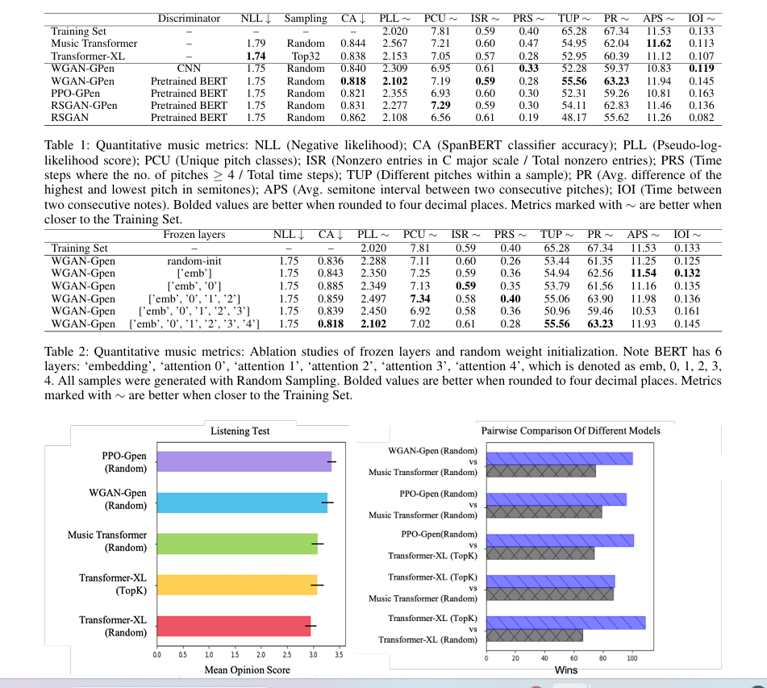

7.Experiments and Results
Transformer-XL demonstrates better performance than the regular Music Transformer, achieving lower NLL and competitive scores across various metrics, while the Transformer-GAN with BERT discriminator surpasses both baseline models in classifier accuracy, suggesting it is the most effective model overall.
Notes:
- **Classifier Accuracy (CA)**: This metric measures the realism of generated music by evaluating a classifier's ability to distinguish between real and generated samples, with lower accuracy indicating better alignment with real data distributions.
- **Pseudo-log-likelihood (PLL)**: Derived from the Masked Language Model objective, this score assesses the quality of music by summing the conditional log probabilities of each token in a sequence, with higher scores indicating closer resemblance to the training set.
- **Quantitative Metrics**: Conventional objective metrics evaluate the generated music by comparing its values to those of real training data, with closer alignment suggesting higher quality, while also reporting validation negative log likelihood (NLL) across generated samples.
- **Human Evaluation**: Participants rate and rank generated music samples based on coherence and consistency in response to predefined priming sequences, providing qualitative insights into the model's performance.

Slide 84
8.Conclusion
The Transformer-GAN framework shows superior performance over traditional Transformer models trained by maximizing likelihood alone, effectively enhancing long-term musical coherence through adversarial loss during training, and there are plans for further improvements by pretraining on larger datasets.
Notes:
Music as Structured Data:
In music, there are hierarchical layers similar to text:
Song (overall structure),
Paragraph (sections of the song, like verses or choruses),
Phrase (musical ideas within sections),
Bar (musical measures),
Beat (small rhythmic units within a bar),
Pixel (even smaller subdivisions, akin to individual notes or sound samples).

Slide 85

Thank You!! Any Questions?

